Slide 1

IST 722 Data Warehouse Project Fudge Corporation Ltd.
Team 2
Tanaya Hirlekar, Business Analyst
Shivani Kulkarni, BI Developer
Kshitij Sankesara, Data Architect
Srinath Ramachandran, Data Engineer

Slide 2
Project Overview
Background-
Fudge Corporation Ltd.
Fudgemart - An online store similar to amazon and walmart
FudgeFlix – A movie rental service similar to netflix
The need to merge for better processes

Slide 3
Project Business Case
The aim of this project is to -
Analyze the needs of data warehouse
Improve business processes
Streamline the workflow
Scalability
Overall robustness of the system

Slide 4
Business Processes
Simple Process:
Product Reviews for Fudgemart (products, customer, product reviews, customer names)
Complex Process:
Product sales (accounts, account billing, plans)(products, order details, orders, customer product reviews, customers)

Slide 5
Tools used
Main ETL tool used – Microsoft SSIS
Processes used - extract, transform and load
Microsoft Power BI tool
Create visualizations
Dashboards for executive decisions

Slide 6
ETL Simple Process
Extract
Transform
Load

Slide 7
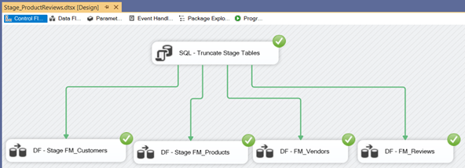
Source to Stage-Control Flow Extraction

Slide 8
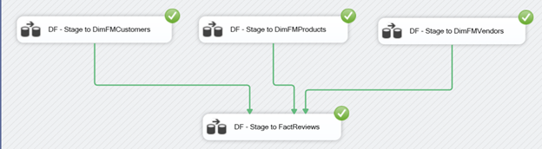
Stage to Datawarehouse-Control Flow Transformation and Loading

Slide 9
ETL Complex Process
Extract
Transform
Load

Slide 10
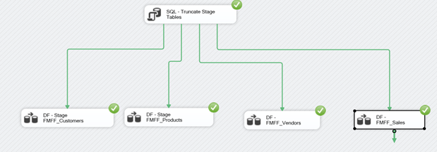
Source to Stage-Control Flow

Slide 11
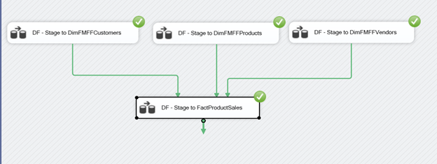
Stage to Datawarehouse

Slide 12
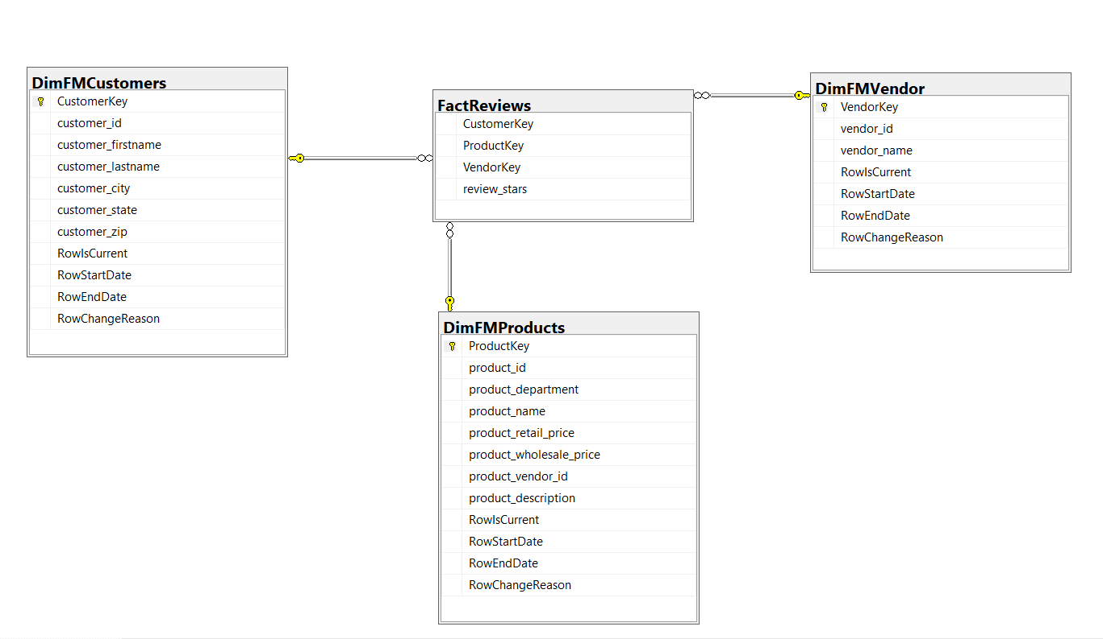
Star Schema Simple Process

Slide 13
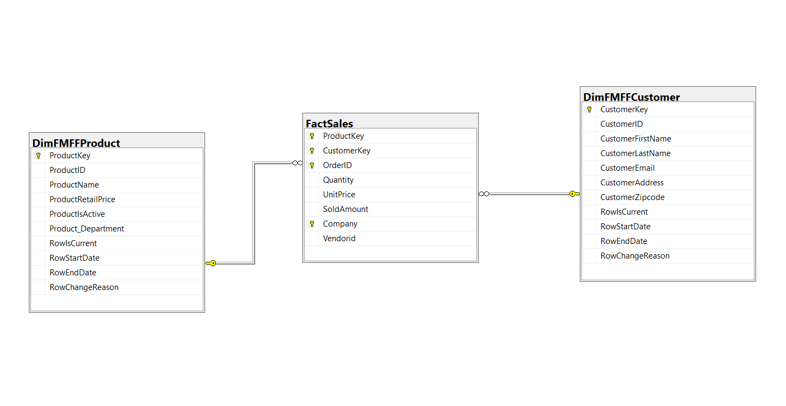
Star Schema Complex Process

Slide 14
Business Intelligence

Slide 15
Business Questions For Simple Process
Product Reviews
What is the most popular product in Fudgemart?
What is the range of reviews?
Which vendor is the most popular?
What is the city which has the most popular products?

Slide 16
Business Questions For Complex Process
Product sales
What is the comparison of the unit price of a product and its selling price?
What are the most popular products?
What is the profit gained from popular products
Top products according to the quantity sold.
Top products according to the selling price.
Profits according to the departments

Slide 17
Data Warehouse Maintenance
Periodically update the warehouse
Keep the Web log lean & regularly delete summarized data
Evaluate whether you must expand your warehouse
Transform data
Keep users of the warehouse well-trained
Update statistic files after you load new data
Notes:
1. Periodically update the warehouse by removing extraneous data and duplicate entries, cleaning up redundant data and inconsistent relationships and defragging tables that are 30 percent or more fragmented.
2. Keep the Web log lean and regularly delete summarized data, as over-congested logs will cause a reduction in performance speed. Back the data into an archive if you must maintain a historical record.
3. Evaluate whether you must expand your warehouse every time you add new profile properties, as every database object can only contain a certain number of properties. The number differs based on the database software being used.
4. Transform data by combining multiple fields into one field; breaking down data fields into separate fields based on year, month and day; mapping related data sets into a single representation; and applying surrogate keys to dimension table records.
5. Keep users of the warehouse well-trained on how to create queries, access database structures and handle unexpected contingencies. Also, review all warehouse changes with staff members before applying them, because the changes might negatively affect a user's ability to acquire the information he needs.
6. Update statistic files after you load new data rebuild an index. Also, run periodic updates either weekly or monthly. Keeping your statistic files updated will optimize query transactions, which in turn will enhance overall performance speed.

Slide 18
Power BI

